Slide 1
1
Before Reading:
2
Making Connections
3
Reading Fluently
Look at the front cover and read the back blurb.
Do you think this is a fiction or non-fiction book?
What will you learn about in this book?
Look at the pictures of a fly’s life cycle on p 14-15.
Draw a picture of the 4 steps of a fly’s life cycle.
Write down what happens to the fly under each picture.
What other insect forms a pupa (or cocoon) and changes into something that can fly?
Find a partner. One of you read the Fly Facts on p 4-7. Then the other person read p. 4-7.
Help each other with any tricky words.
Write down 1 interesting fact about flies.
4
Answer This
5
6
Making Connections
Fly Facts
By Janice Marriott & Andy Keylock
(Big Cats)
How many times can a fly beat its wings in a second?
Read p 8-9. How can flies make you sick?
Name 3 animals that eat flies.
How do maggots move around?
How far do flies go looking for food?
Imagine that you are a fly.
What would be the best thing about being a fly?
What would be the worst thing about being a fly?
7
Exploring Words - Nouns
8
Picture This!
9
Share what you Know
A noun is a person, place or thing.
Read p 17 again. Find 4 nouns on these pages.
Write down the 4 nouns.
Write sentences with the 4 nouns you found.
You have been learning about flies.
Write down 5 interesting facts about flies in your jotters.
Using your Fly Facts template, write a paragraph about flies.
Read your paragraph to the class.
Look at p 22-23.
Draw a detailed picture of a fly.
Label the fly’s eyes, wings, legs, feet and body.

Slide 2
1
Before Reading:
2
Making Connections
3
Reading Fluently
I can
Decide whether a book is fiction or non-fiction
Read the blurb and write down what my book is about.
I can
Draw and write about the 4 steps in a fly’s life cycle
Write down another insect that is like a fly
I can
Take turns with a partner.
Help my partner with tricky words
Write down one interesting fact about flies
4
Answer This!
5
6
Making Connections
I can
Read my book carefully.
Answer questions about flies.
Write in complete sentences.
Number my sentences.
Start a new line for each new answer.
Fly Facts
Success Criteria
I can
Write down one thing that would be fun about being a fly
Write down one thing that would not be fun about being a fly
7
Exploring Words
8
Be Creative!
9
Share What you Know
I can
Draw and label a detailed picture of a fly
I can
Write down 5 interesting facts about flies in my jotter
Write a paragraph about flies on my template
Read my paragraph to the class
I can
Find 4 nouns.
Write sentences with these nouns.

Slide 3
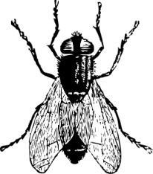
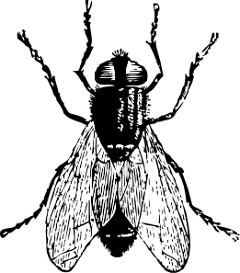
Name: _____________________ Date: _________________________
Fly Facts
_________________________________________________________________________
_________________________________________________________________________
_________________________________________________________________________
_________________________________________________________________________
_________________________________________________________________________
_________________________________________________________________________
_________________________________________________________________________
_________________________________________________________________________
__________________________________________________________
__________________________________________________________

